Slide 1

Clustering Music by Genres Using
Supervised and Unsupervised Algorithms
Mrittika Das (A25CE09011) | Anjali Sanjay Kashide (25AI06001)
Anwesha Chakraborty (25CL06002) | Sayali Abhay Khamitkar (22CS01052)
Indian Institute of Technology Bhubaneswar

Slide 2


Introduction
Goal
Automatically classify music genres using raw audio signals.
Approach
Apply DFT-based features with SVM and CART (supervised) and K-means (unsupervised).

Slide 3
Data Preparation Workflow
Collected 40 songs per genre from YouTube
Downloaded audio using yt-dlp
Converted to mono & resampled to 44.1 kHz
Converted MP3 files to WAV format
Trimmed all audio to 30 seconds
Applied FT for frequency-domain analysis
Extracted 20 mel-band features (0–2000 Hz)
Stored features in 4 CSV files
Combined all CSVs into one final dataset

Slide 4
Methodology
Data: 40 samples per genre (Classical, Pop, Jazz, Rock)
Features: DFT, XM feature sets
Supervised: SVM and CART using train / test samples per genre
Unsupervised: PCA + K-means clustering

Slide 5
CART Classification
Input: Combined normalized Mel-features.
80/20 train–test split.
Best Recall: Pop (1.00), Jazz (0.88) (high recall ) model identifies them very well.
Lower Recall: Classical (0.62), Rock (0.50) - more misclassifications
Interpretation: Many genres share frequency patterns - moderate separability
High precision for Classical & Rock - when predicted, they are correct.
Accuracy: 0.75 Most important features: f1, f7, f20, f11

Slide 6
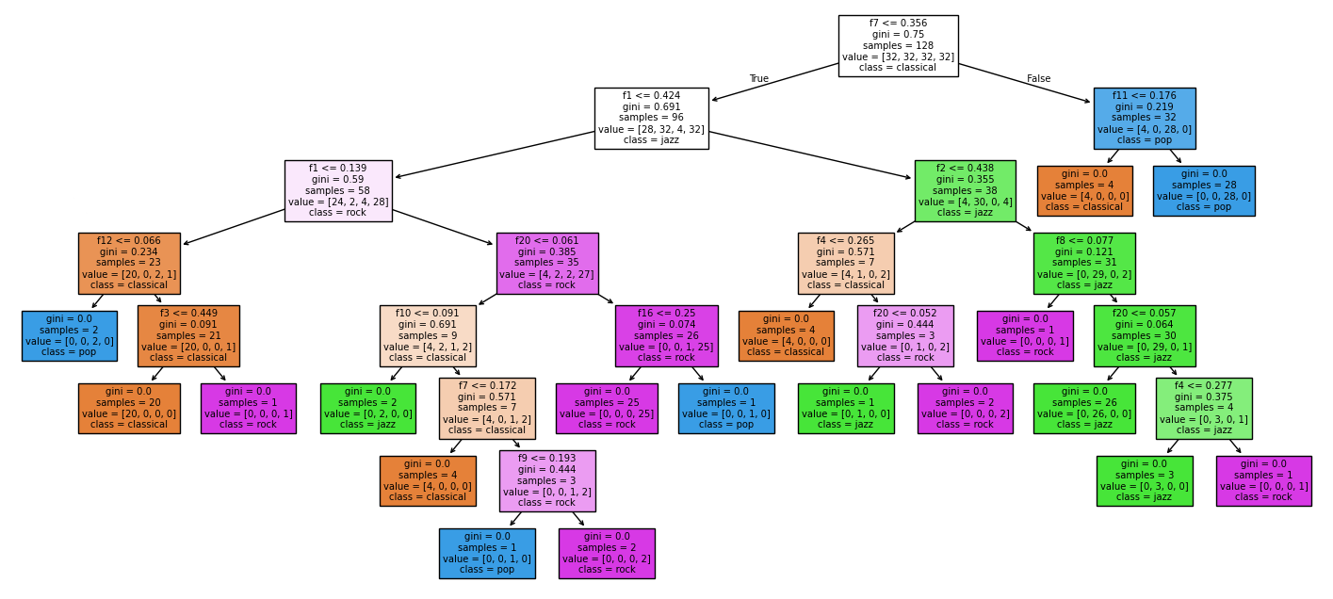
CART
(Decision Tree)

Slide 7
K-Means Clustering
Input: Standardized 20-D Mel features (before PCA)
Insights (Without PCA ): Many samples collapsed into one cluster;
Classical separated best, others overlapped
Insights (With PCA): Better structure than without PCA but clusters still overlap

Slide 8

Support Vector Machine (SVM) Classification
Captures non-linear patterns effectively
Very high classification accuracy
Strong precision and recall across genres
Strong ability to generalize to new audio samples
Feature scaling essential for performance

Slide 9
Conclusion
The results confirm that supervised learning—particularly SVM—captures genre-specific patterns far more effectively than CART or unsupervised clustering methods
SVM performs best → highest accuracy & strongest genre separation
CART is moderate → works but limited by overlapping feature patterns
K-Means struggles → unsupervised clustering insufficient with current features

Slide 10


References
K. Kim, W. Yun, and R. Kim, “Clustering Music by Genres Using Supervised and Unsupervised Algorithms,” 2024

Slide 11

Thank You

